Slide 1


TOPIC: Books Exchange platform
LECTURER: DR AMY HAMIDAH
Name | Matric ID
Liu Ruoyang | A23MJ4022
Kahlan Sultan Mohammed | A23MJ4021
Bu Guoshun | A23MJ4019

Slide 2



Team members
Kahlan Sultan Mohammed
Bu Guoshun
Liu Ruoyang

Slide 3


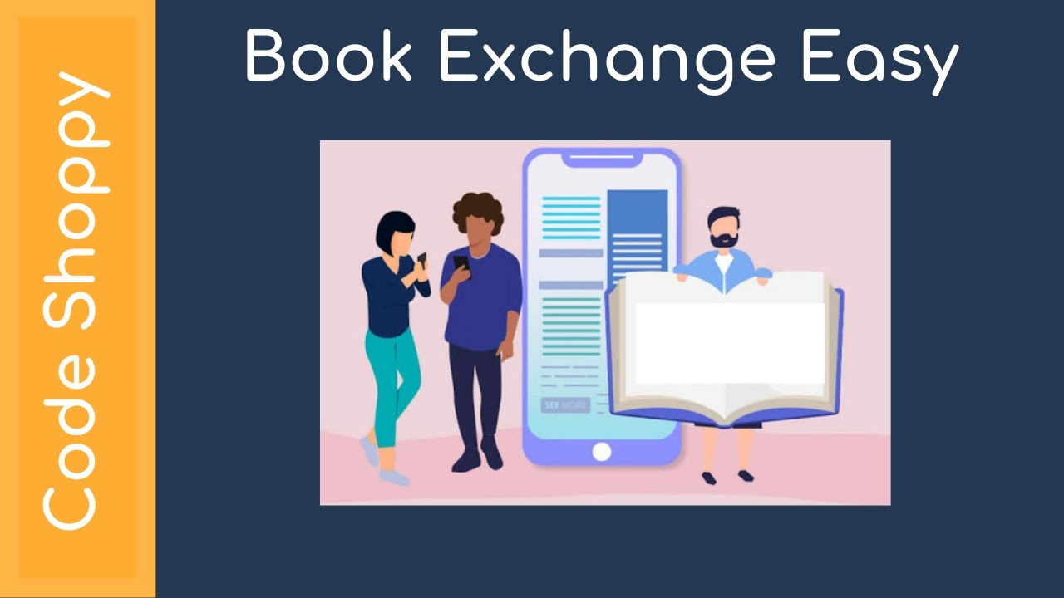
Introduction:
Our proposed "Book Exchange Platform" aims to alleviate the financial burden of textbooks for students amidst the rising costs of education. Students can buy, sell, or exchange textbooks and course materials with their peers, by passing costly intermediaries. Key features include secure transactions, cost savings, and environmental sustainability. This platform not only meets students' needs but also fosters community and sustainability. With sponsorship support, our goal is to revolutionize access to course materials globally.

Slide 4
Project Objectives
1.Increase Accessibility: Provide students with a convenient platform to access affordable textbooks and course materials.
2.Alleviate Financial Pressure: Reduce students' financial burden by offering cost-effective options for textbooks.
3.Promote Community Engagement: Cultivate an inclusive environment for students to connect and collaborate.
These objectives reflect our vision of educational equity and student success, aiming to create a global learning environment that is open, inclusive, sustainable, and collaborative.

Slide 5
PROBLEM STATEMENT
1. Difficulty in Finding Specific Books
Users struggle to find specific books due to inadequate search functionality.
2. Communication Barriers
It is challenging for users to contact each other to arrange exchanges.
3. Lack of Real-Time Updates
The current system does not provide real-time updates on book availability, making it difficult to know if a book is available or already lent out.
4. No Exchange Records
The absence of exchange records makes it difficult to resolve disputes when returning books.

Slide 6
PROPOSED SOLUTIONS
Enhanced Search Functionality
Implement a robust search feature to filter books by category, title, author, etc., for easy discovery
Direct Communication Channels
Provide a dedicated communication page for borrowers and lenders, enabling them to send messages and arrange exchanges directly.
Real-Time Availability Updates
Ensure real-time updates on book availability; automatically mark books as lent and close their public exchange link when borrowed.
Exchange Records
Maintain exchange records with personal information accessible on the communication page until both parties complete the exchange, then destroy records once finalized. Users can seek help through the platform in case of disputes.

Slide 7
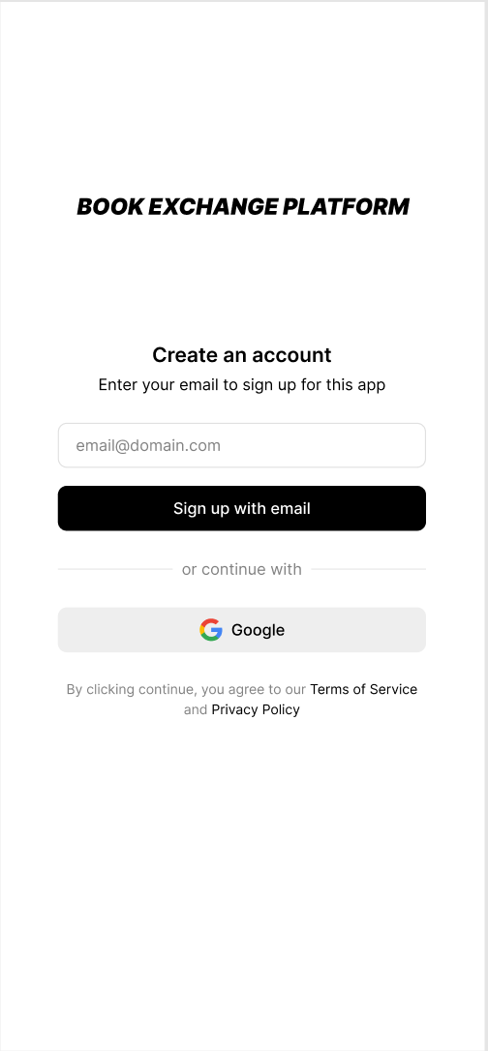
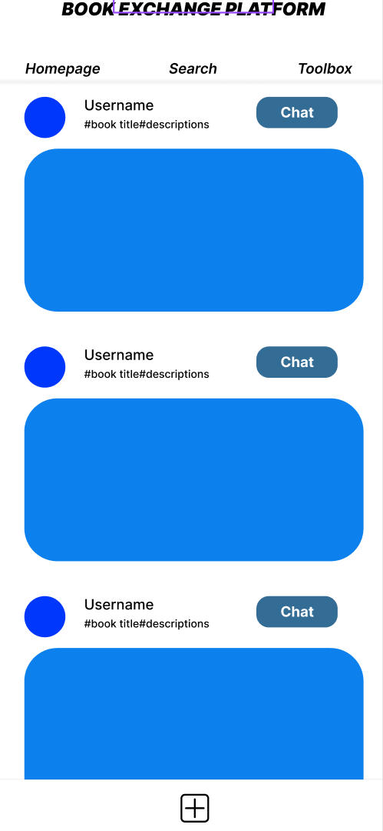
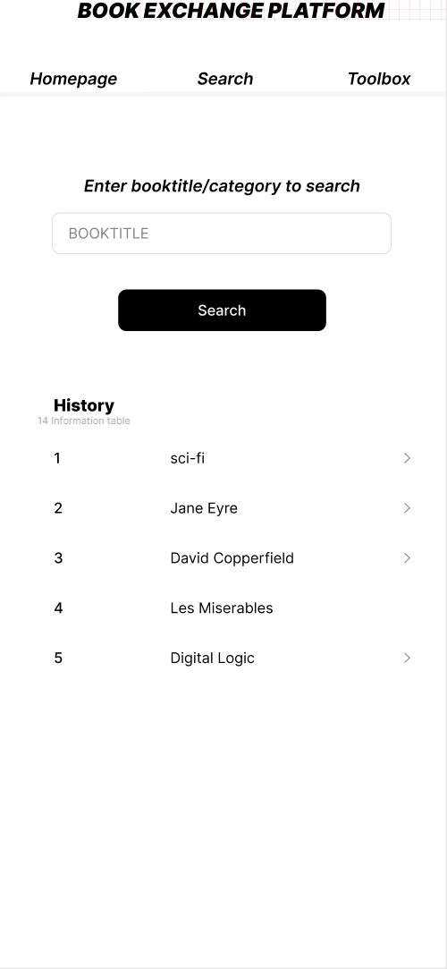
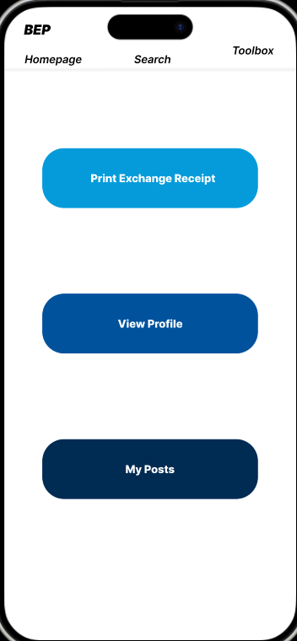
PROTOTYPE of the BOOK EXCHANGE PLATFORM
Sign in
Homepage
Search
Toolbox

Slide 8
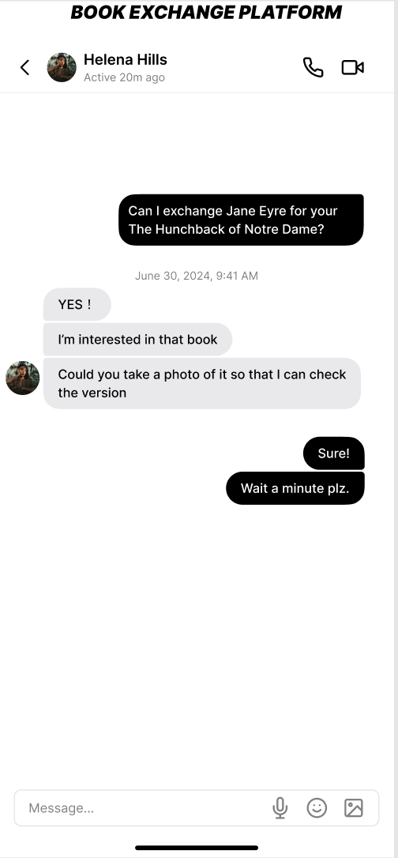
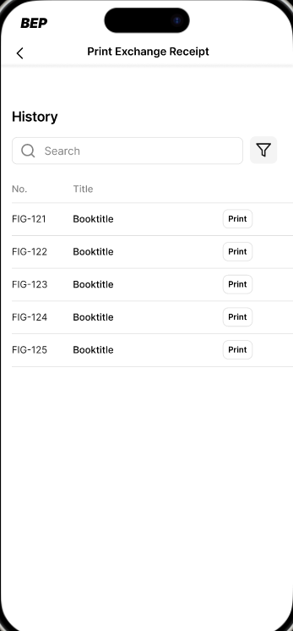
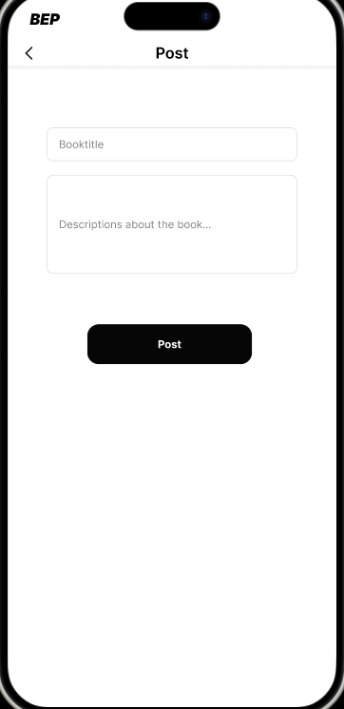
Receipt Printing
Posts
One-on one Chat

Slide 9

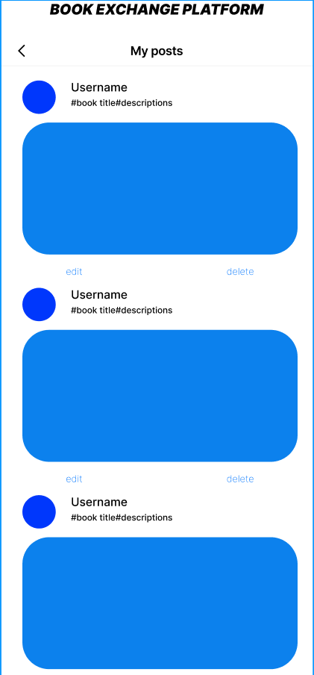
Profile
My Posts

Slide 10
Summary

Slide 11
For reading, some people choose e-books, while others seek the immersive experience of physical books. To help more people who need to exchange physical books, we decided to create this system. We hope this system can save people money on books, provide more reading options, and help people make like-minded friends. We will continuously update and improve this system to ensure its operation and better service.

Slide 12
THANKS FOR LISTENING

